Slide 1
Reflections on Leadership
Barry L. Shoop, Ph.D.
IEEE Region 1 Director
Science Advisor
Office of the Deputy Secretary of Defense
Joint IED Defeat Organization
Washington, DC
~~~~~~~~~~~~~~~
Professor and Director, Electrical Engineering Program
Department of Electrical Engineering and Computer Science United States Military Academy, West Point, New York
August 18, 2006
The Sheraton Syracuse University – Hotel & Convention Center
Syracuse, New York

Slide 2
Agenda
Purpose
Leadership Development
Leader Traits
Managers and Leaders
Understanding Individual & Group Dynamics
Personal Reflections
Expectations
To lead people, walk beside them ...
As for the best leaders, the people do not notice their existence.
The next best, the people honor and praise.
The next, the people fear;
and the next, the people hate ...
When the best leader's work is done the people say,
"We did it ourselves!" — Lao-tsu

Slide 3
Purpose
Dialog with the IEEE – Region 1 Leadership Team.
Raise awareness of the importance of effective leadership.
Communicate expectations.
Never tell people how to do things. Tell them what to do and they will surprise you with their ingenuity.
— George Patton

Slide 4
Initial Thoughts
Good leaders are made not born. If you have the desire and willpower, you can become an effective leader. Good leaders develop through a continuous process of self-study, education, training, experience, and reflection.
Leadership is a process by which a person influences others to accomplish an objective and directs the organization in a way that makes it more cohesive and coherent.
Although your position may give you the authority to accomplish certain tasks and objectives in your organization, power or authority does not make you a leader ... it simply makes you the boss.
Leadership differs in that it makes the followers want to achieve high goals, rather than simply bossing people around.
Do you wish to rise? Begin by descending. You plan a tower that will pierce the clouds? Lay first the foundation of humility.
— St. Augustine

Slide 5

Leadership Development
+ New Knowledge
Reading about leadership
Observing other leaders
Studying leadership theory
+ Experiences
Leading other people
Serving under others
Peer leadership
Individual challenges
You
+ Reflection
Self awareness
Taking ownership of your development
Mentoring, counseling, feedback
After Action Reviews
Whoever is careless with the truth in small matters cannot be trusted with the important matters.
— Albert Einstein

Slide 6
Leadership Theory
Bass' theory of leadership states that there are three basic ways to explain how people become leaders. The first two explain the leadership development for a small number of people.
Trait Theory. Some personality traits may lead people naturally into leadership roles.
Great Events Theory. A crisis or important event may cause a person to rise to the occasion, which brings out extraordinary leadership qualities in an ordinary person.
Transformational Leadership Theory. People can choose to become leaders and can learn leadership skills. It is the most widely accepted theory today.
The basis of good leadership is honorable character and selfless-service to your organization. Your leadership is everything you do that effects the organization's objectives and the well being of those that follow you. Respected leaders concentrate on what they are [be] (such as beliefs and character), what they [know] (such as job, tasks, and human nature), and what they [do] (such as implementing, motivating, and provide direction).
What makes a person want to follow a leader? People want to be guided by those they respect and who have a clear sense of direction. To gain respect, the leader must be ethical. A sense of direction is achieved by conveying a strong vision of the future.
What you cannot enforce, do not command.
— Sophocles

Slide 7
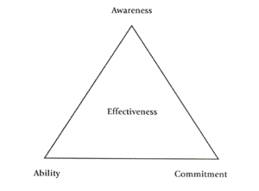

Other Theories
There are a number of other leadership theories.
Leadership, according to Peter A. DeLisle, is the ability to influence other people, with or without authority – including technical as well as group and organizational leadership, since all successful endeavors are the result of human effort.
DeLisle goes on to suggest that leadership effectiveness is dependent on three things: awareness, ability and commitment.
Engineering Leadership
by Peter A. DeLisle
Severns Project on Engineering Education
University of Illinois, Urbana-Champaign
A leader is a dealer in hope.
— Napoleon Bonaparte

Slide 8
Principles of Leadership
To help you be, know, and do; follow these eleven principles of leadership
Know yourself and seek self-improvement - In order to know yourself, you have to understand your own attributes. Seek self-improvement, continually strengthening your attributes. This can be accomplished through self-study, formal classes, reflection, practice, and interacting with others.
Be technically proficient - As a leader, you must know your job and those of your subordinates.
Seek responsibility and take responsibility for your actions - Search for ways to guide your organization to new heights. When things go wrong, take responsibility and do not blame others. Analyze the situation, take corrective action, and move on to the next challenge.
Make sound and timely decisions - Use good problem solving, decision making, and planning tools.
Set the example - Be a good role model for your employees. They must not only hear what they are expected to do, but also see.
U.S. Army Handbook (1973). Military Leadership.
We must become the change we want to see.
— Mahatma Gandhi

Slide 9
Principles of Leadership
Know your people and look out for their well-being - Know human nature and the importance of sincerely caring for your people.
Keep everyone informed - Know how to communicate not only with your subordinate, but also seniors and other key people.
Develop a sense of responsibility in those you lead - Help to develop good character traits that will help them carry out their professional responsibilities.
Ensure that tasks are understood, supervised, and accomplished - Communication is the key to this responsibility.
Train as a team - Although many so called leaders call their organization, department, section, etc. a team; they are not really teams...they are just a group of people doing their jobs.
Use the full capabilities of your organization - By developing a team spirit, you will be able to employ your organization, department, section, etc. to its fullest capabilities.
People cannot be managed. Inventories can be managed, but people must be led.
— H. Ross Perot

Slide 10
Leadership Framework: Be-Know-Do
BE a professional - be loyal to the organization, perform selfless-service, take personal responsibility.
BE a professional who possess good character traits - honesty, competence, candor, commitment, integrity, courage.
KNOW the four factors of leadership - follower, leader, communication, situation.
KNOW yourself - strengths and weakness of your character, knowledge, and skills.
KNOW human nature - human needs, emotions, and how people respond to stress.
KNOW your job - be proficient and be able to train others in their tasks.
KNOW your organization - where to go for help, its climate and culture, who the unofficial leaders are.
DO provide direction - goal setting, problem solving, decision making, planning.
DO implement - communicating, coordinating, supervising, evaluating.
DO motivate - develop moral and esprit in the organization, train, coach, counsel.
If the blind lead the blind, both shall fall into the ditch.
— The Bible

Slide 11
The Process of Great Leadership
The road to great leadership (Kouzes & Posner, 1987) that is common to successful leaders:
Challenge the process - First, find a process that you believe needs to be improved the most.
Inspire a shared vision - Next, share you vision in words that can be understood by your followers.
Enable others to act - Give them the tools and methods to solve the problem.
Model the way - When the process gets tough, get your hands dirty. A boss tells others what to do...a leader shows that it can be done.
Encourage the heart - Share the glory with your followers' heart, while keeping the pains within your own.
Pull the string, and it will follow wherever you wish. Push it, and it will go nowhere at all.
— Dwight D. Eisenhower

Slide 12
Effective Leader Traits
Vision – Set the course and have the conviction to follow-through.
Goals – Establish achievable goals.
Passion – Positive outlook and are passionate about their goals.
Integrity – Know your strength and weaknesses.
Honesty – Earn the trust of the followers.
Curiosity - Leaders are learners.
Risk – Take calculated risks and learn from mistakes.
Dedication – Commitment to the cause.
Charisma – Maturity, respect, compassion, and a sense of humor.
Listening – Effective leaders actively listen.
The task of the leader is to get his people from where they are to where they have not been.
— Henry Kissinger
Ray Findlay, “Some Thoughts on Leadership”, 2004 Region 1 Summer Training Workshop, Sturbridge, MA

Slide 13
What Do Effective Leaders Do?
The Effective Leader:
  Sets the direction, gives guidance, and motivates people.
  Carries out the will of the group.
  Is the champion for the cause of the group.
  Guides the group during times of storm.
  Knows what they want, why, and how to communicate it.
  Recognizes and praises good work.
Men make history and not the other way around. In periods where there is no leadership, society stands still. Progress occurs when courageous, skillful leaders seize the opportunity to change things for the better.
— Harry Truman
Ray Findlay, “Some Thoughts on Leadership”, 2004 Region 1 Summer Training Workshop, Sturbridge, MA

Slide 14
Being an Effective Leader
Think great thoughts.
Turn disasters into opportunities. Obstacles are opportunities.
Determine your "real" goals then strive to achieve them.
When you want to tell someone something important, do it personally.
Make coffee.
You do not lead by hitting people over the head — that's assault, not leadership.
— Dwight D. Eisenhower
Ray Findlay, “Some Thoughts on Leadership”, 2004 Region 1 Summer Training Workshop, Sturbridge, MA

Slide 15
Leaders and Managers
Many in professional societies have managerial and business experience.
Managers plan, organize, minimize risk, maximize profit, …
Leader – noun, (1) A person who is followed by others. (2) The horse placed at the front in a team or pair.
Manager – noun, (1) A person controlling or administering a business or a part of a business. (2) A person regarded in terms of skill in household or financial or other management.
Management is doing things right; leadership is doing the right things.
— Peter F. Drucker

Slide 16
Individual & Group Dynamics
Attempt to identify and understand individual and interpersonal dynamics
of the group.
If you will lead this group over an extended period, consider the Myers-
Briggs Type Indicator (MBTI) instrument.
  Not definitive but allows you to better understand the members of your
  meeting.
  Most scientists and engineers are introverts – prefer to sit-back, listen
  and think-through their response.
  Extroverts tend to develop their opinions and responses by talking out-
  loud.
126 item Myers-Briggs Type Indicator (MBTI)
  Instrument publisher, Consulting Psychologists Press (CPP, Inc.)
Leadership is the art of getting someone else to do something you want done because he wants to do it.
— Dwight D. Eisenhower

Slide 17
Personality Types
The sixteen personality types which we use in our assessment are based on the well-known research of Carl Jung, Katharine C. Briggs, and Isabel Briggs Myers
The theory of Personality Types, as it stands today, contends that:
  An individual is either primarily Extraverted or Introverted
  An individual is either primarily Sensing or iNtuitive
  An individual is either primarily Thinking or Feeling
  An individual is either primarily Judging or Perceiving
The possible combinations of the basic preferences form 16 different Personality Types.
Learning about other people's Personality Types help us to understand the
most effective way to communicate with them, and how they function best.
Leadership is a combination of strategy and character. If you must be without one, be without the strategy.
— H. Norman Schwarzkopf

Slide 18
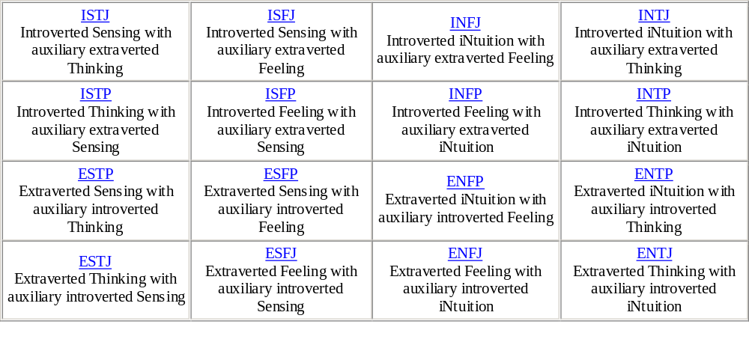
MBTI
If your actions inspire others to dream more, learn more, do more and become more, you are a leader.
— John Quincy Adams

Slide 19
MBTI Type Descriptions
The developed theory today is that every individual has a primary mode of operation within four categories:
  1. Our flow of energy
  2. How we take in information
  3. How we prefer to make decisions
  4. The basic day-to-day lifestyle that we prefer
Within each of these categories, we "prefer" to be either:
  1. Extraverted or Introverted
  2. Sensing or iNtuitive
  3. Thinking or Feeling
  4. Judging or Perceiving
Leaders aren't born they are made. And they are made just like anything else, through hard work. And that's the price we'll have to pay to achieve that goal, or any goal.
— Vincent Lombardi

Slide 20
Personal Reflections
People expect you to be the leader – lead!
Set the example. Don’t be afraid to get involved and do the work.
Be available – visit your people where they are.
The troops always come first.
Use face-to-face communication wherever possible.
Great leaders are almost always great simplifiers, who can cut through argument, debate, and doubt to offer a solution everybody can understand.
— General Colin Powell

Slide 21
Expectations
Know your role, responsibility, and authority.
Be passionate about your profession – passion is contagious!
Be actively involved – lead!
Set the example.
Take the time to get to know your members.
Take the time to recognize the contributions of your volunteers.
Identify problems – provide recommendations.
Identify, cultivate, and mentor next generation of leaders.
Improve the effectiveness of your organization.
Leadership is about setting the conditions so others can succeed.
— Barry L. Shoop

Slide 22
References
Bass, Bernard (1989). Stogdill's Handbook of Leadership: A Survey of Theory and Research. New York: Free Press.
Bass, Bernard (1990). From transactional to transformational leadership: learning to share the vision. Organizational Dynamics, Vol. 18, Issue 3, Winter, 1990, 19-31.
Blake, Robert R. and Mouton, Janse S. (1985). The Managerial Grid III: The Key to Leadership Excellence. Houston: Gulf Publishing Co.
Bolman, L. and Deal, T. (1991). Reframing Organizations. San Francisco: Jossey-Bass.
Kouzes, James M. & Posner, Barry Z. (1987). The Leadership Challenge. San Francisco: Jossey-Bass.
U.S. Army Handbook (1973). Military Leadership.

Slide 23
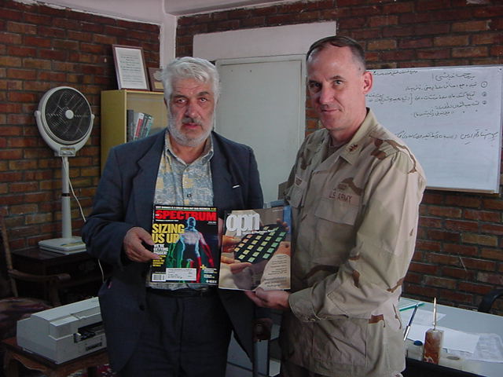

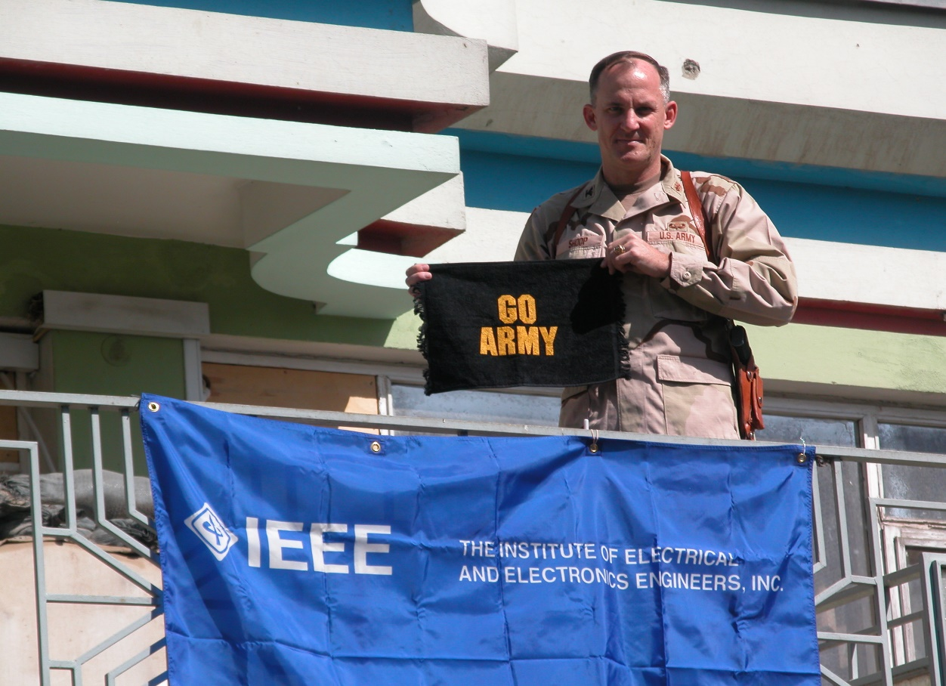
The IEEE Mission
The IEEE promotes the engineering process of creating, developing, integrating, sharing, & applying knowledge about electro and information technologies & sciences for the benefit of humanity & the profession.
Never Leave Home Without It!

Slide 24
Questions?
The Leadership Workshop
Take advantage of the speaker’s expertise.
Participate
– contribute
– ask questions
– exchange ideas
- best practices

